Slide 1

August 2018
Sarah Stone, co-Executive Director, eScience Institute

Slide 2
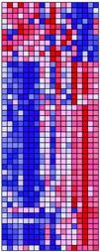

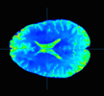
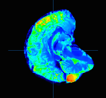
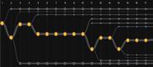
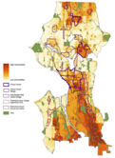
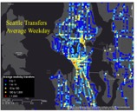
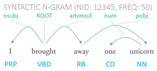
Our Society is Facing a Data Deluge
Science: sensors, instruments, simulations, lab automation, etc.
Industry: search logs, social media, etc.
Government: records, sensors, documents, etc.
MyMergerTree Screenshot @ UW
Data from the Human Connectome project
Picture from Deep Lens Survey (DLS: Tyson)
From Prof Su-In Lee @ UW
Map of average Seattle ORCA transfers per weekday
From: DSSG @ UW 2016
Seattle Comprehensive Plan Equity Analysis, 2016, page 17
From: DSSG @ UW 2017
From Leila Zilles @ UW
Notes:
Our ability to acquire data is vastly outpacing our ability to learn from it!
A proliferation of sensors
Dramatic instrumentation advancements
Ever more powerful models producing ever more data
The creation of almost all information in digital form
Dramatic cost reductions in storage and computation
Dramatic improvements in scalability and network bandwidth
Algorithmic breakthroughs in areas such as machine learning

Slide 3
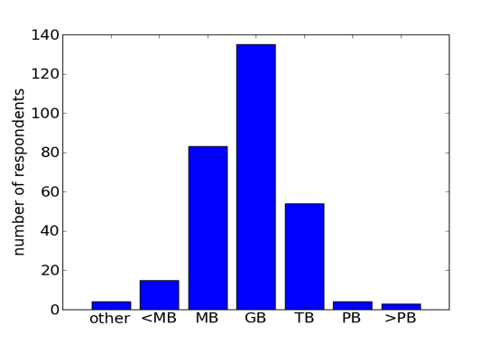
Data Science challenges go beyond size
How much data do you work with?
Wright 2013
Notes:
Data science challenges don’t emerge just at the massive data level. Researchers struggle with organizing, managing, analyzing, querying data in the GB range because data sets can be complex, messy, heterogeneous and/or arrive at high velocity (instrumentation).

Slide 4
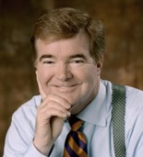
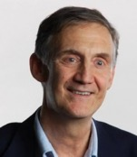
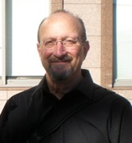
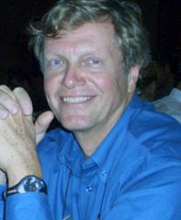
The Beginning
Initial Concept and Institute Founded
“All across our campus, the process of discovery will increasingly rely on researchers’ ability to extract knowledge from vast amounts of data... In order to remain at the forefront, UW must be a leader in advancing these techniques and technologies, and in making [them] accessible to researchers in the broadest imaginable range of fields.”
Mark Emmert
Ed Lazowska, CSE
Tom Daniel, Biology
Werner Stuetzle, Statistics
Notes:
To remain at the forefront, researchers in all fields will need access to
state-of-the-art data science methodologies and tools
These methodologies and tools will need to advance rapidly, driven by the
requirements of discovery
Data science is driven more by intellectual infrastructure (human capital) and
software infrastructure (shared tools and services – digital capital) than by
hardware

Slide 5





First Turning Point
Genesis of the Moore/Sloan “Data Science Environments” effort
Foundations recognize the emergence of data-intensive discovery as an important new approach that would lead to new advances in research
They perceived a number of impediments to success
They sought partners who were prepared to work together in a distributed collaborative experiment focused on tackling these impediments
Notes:
Our collaboration began in May 2013 when our universities were invited by the Foundations to participate in the design process to develop new kinds of academic environments for data-intensive
discovery. At a retreat in June 2013 we identified a set of barriers to adoption, and formed
cross-university Working Groups to develop approaches to reducing these barriers.

Slide 6

Second Turning Point
The Washington Research Foundation
UW Provost allocates a number of half faculty positions to accelerate the recruiting of “Pi-shaped” faculty
Faculty with expertise both in data science methodologies and in data science application areas
WRF gift provides Chairs, Professorships, and startup funds to enable us to attract and retain the very strongest people to these positions
WRF gift also enables us to remodel and equip our space: the WRF Data Science Studio

Slide 7

Third Turning Point
A Permanent Institute Looking Toward a Bright Future
May 10th 2018, eScience received permanent funding from the Provost
From start-up to permanent organization…
Expand our reach and collaborations across campus
Increase the breadth and depth of data scientist staff expertise
Support both beginning & advance data science activities
Foster industry partnerships & entrepreneurship

Slide 8
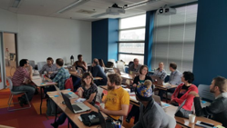
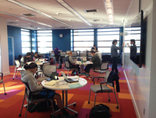
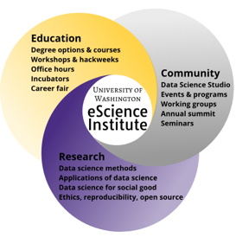

UW eScience Institute Since 2008
The eScience Institute empowers researchers and students in all fields to answer fundamental questions through the use of large, complex, and noisy data. As the hub of data-intensive discovery on campus, we lead a community of innovators in the techniques, technologies, and best practices of data science and the fields that depend on them.

Slide 9

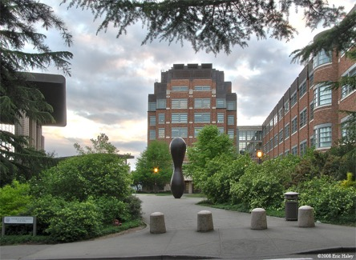

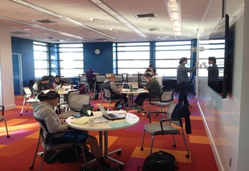
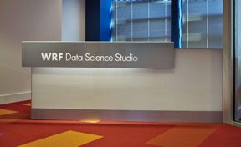
WRF Data Science Studio
Thanks to partnership with libraries

Slide 10

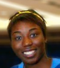


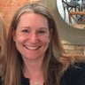
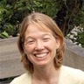




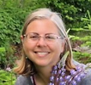
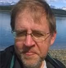


Who We Are?
Data Scientists
Founding Director
Ed Lazowska
Ph.D. Computer Science
Director
Executive Directors
Director of Research
Bernease Herman
B.S. Statistics
Formerly SE at Amazon
Ariel Rokem
Ph.D. Neuroscience
Magdalena Balazinska
Ph.D. Computer Science
David Beck
Ph.D. Medicinal Chemistry,
Biomolecular Struct. & Design
Micaela Parker
Ph.D. Oceanography
Sarah Stone
Ph.D. Oceanography
Events
Communications
Cloud Solutions
Valentina Staneva
Ph.D. Applied
Mathematics and
Statistics
Jake VanderPlas
Director of Open
Software
Ph.D. Astronomy
Rob Fatland
Director of Cloud &
Data Solutions
Ph.D. Geophysics
Amanda Tan
Cloud Technology Lead Developer
Ph.D. Civil & Env. Eng.
Rachael Murray
Program Specialist
Robin Brooks
Communications Associate
Jose Hernandez
PhD Measurement
& Statistics

Slide 11

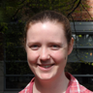


Research Scientists
Anthony Arendt
Ph.D. Geophysics
APL
Bryna Hazelton
Ph.D. Astrophysics
Physics
Joe Hellerstein
Ph.D. Computer Science
IBM Research, Microsoft Research, Google (ret.)
Vaughn Iverson
Ph.D. Oceanography
Oceanography

Slide 12
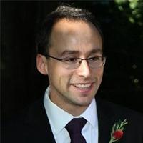
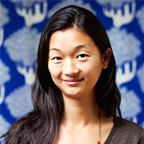


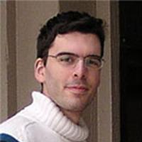
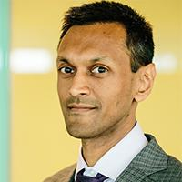
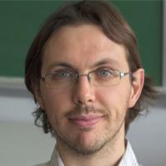
Provost Hire Faculty & Many More Affiliates
100+ affiliated faculty
Sasha Aravkin
Applied Mathematics
Bingni Brunton
Biology
Steve Brunton
Mechanical Engineering
Zaid Harchaoui
Statistics
Mario Juric
Astronomy
Sham Kakade
CSE + Statistics
Emilio Zagheni
Sociology
Notes:
Sasha: Convex and Variational Analysis, ML, nonconvex optimization, etc.
Bing: Data intensive approaches to understand the brain
Steve Brunton: Data science for control: machine learning, uncertainty quantification, and equation-free modeling, model reduction
Zaid: ML, feature representations for signalsand images
Mario Juric: Data Management Project Scientist for the Large Synoptic Survey Telescope.
Sham Kakade: theoretical and applied questions in machine learning and artificial intelligence
Emilio Zagheni: big data in demography (causes and consequences of demographic change using mathematical,statistical, and computaitonal approaches.

Slide 13
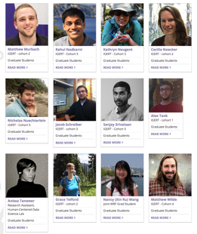
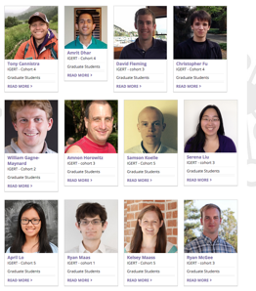
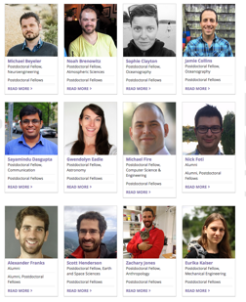
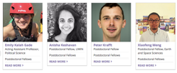
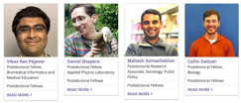
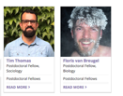
Postdocs and PhD Students
NSF IGERT
(awarded in 2013)
Moore/Sloan & WRF Innovation in Data Science Postdoctoral Fellows

Slide 14
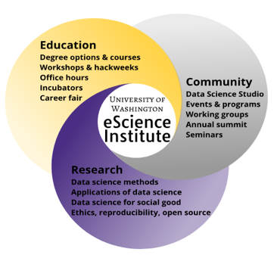
eScience Institute Role at the U of Washington and Beyond
Education
Disseminate Data Science Expertise and Best Practices
Lead Data Science Education at UW
Research
Advance the State of the Art in Data Science
Make the World a Better Place
Community
Hub of data science community
Partnerships
Notes:
Informal and formal education offerings

Slide 15
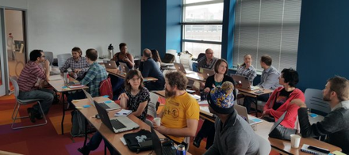
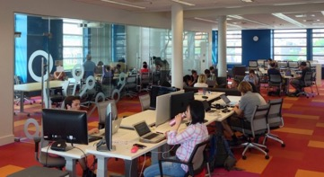
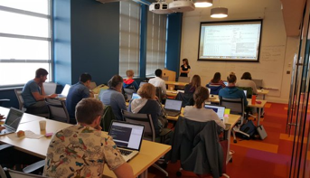
We Disseminate Data Science Expertise and Best Practices
Open Office Hours (drop-in Consulting)
Seminars
Tutorials (e.g. Reproducibility Tools)
Workshops (e.g. The Carpentries)
Hack weeks
Notes:
We consult, educate, evangelize, and contribute to data science methods and scientific discovery.

Slide 16
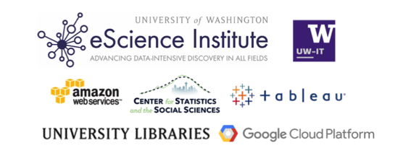
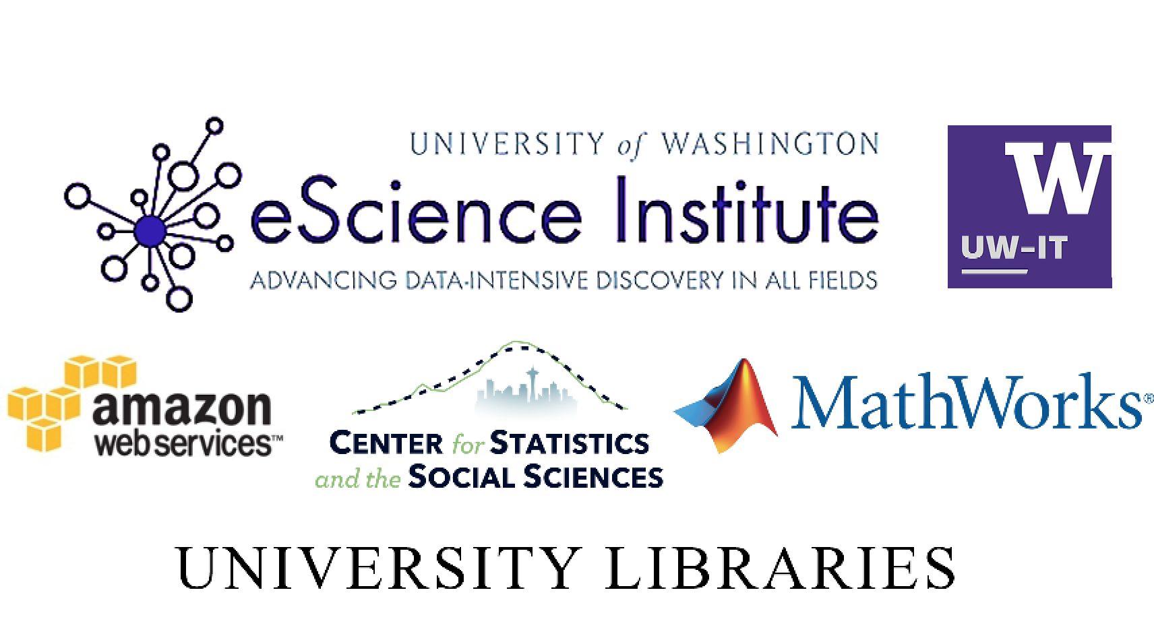
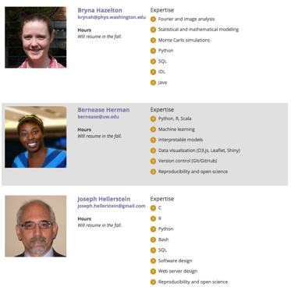
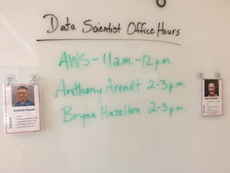
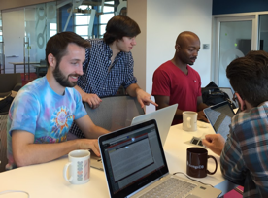
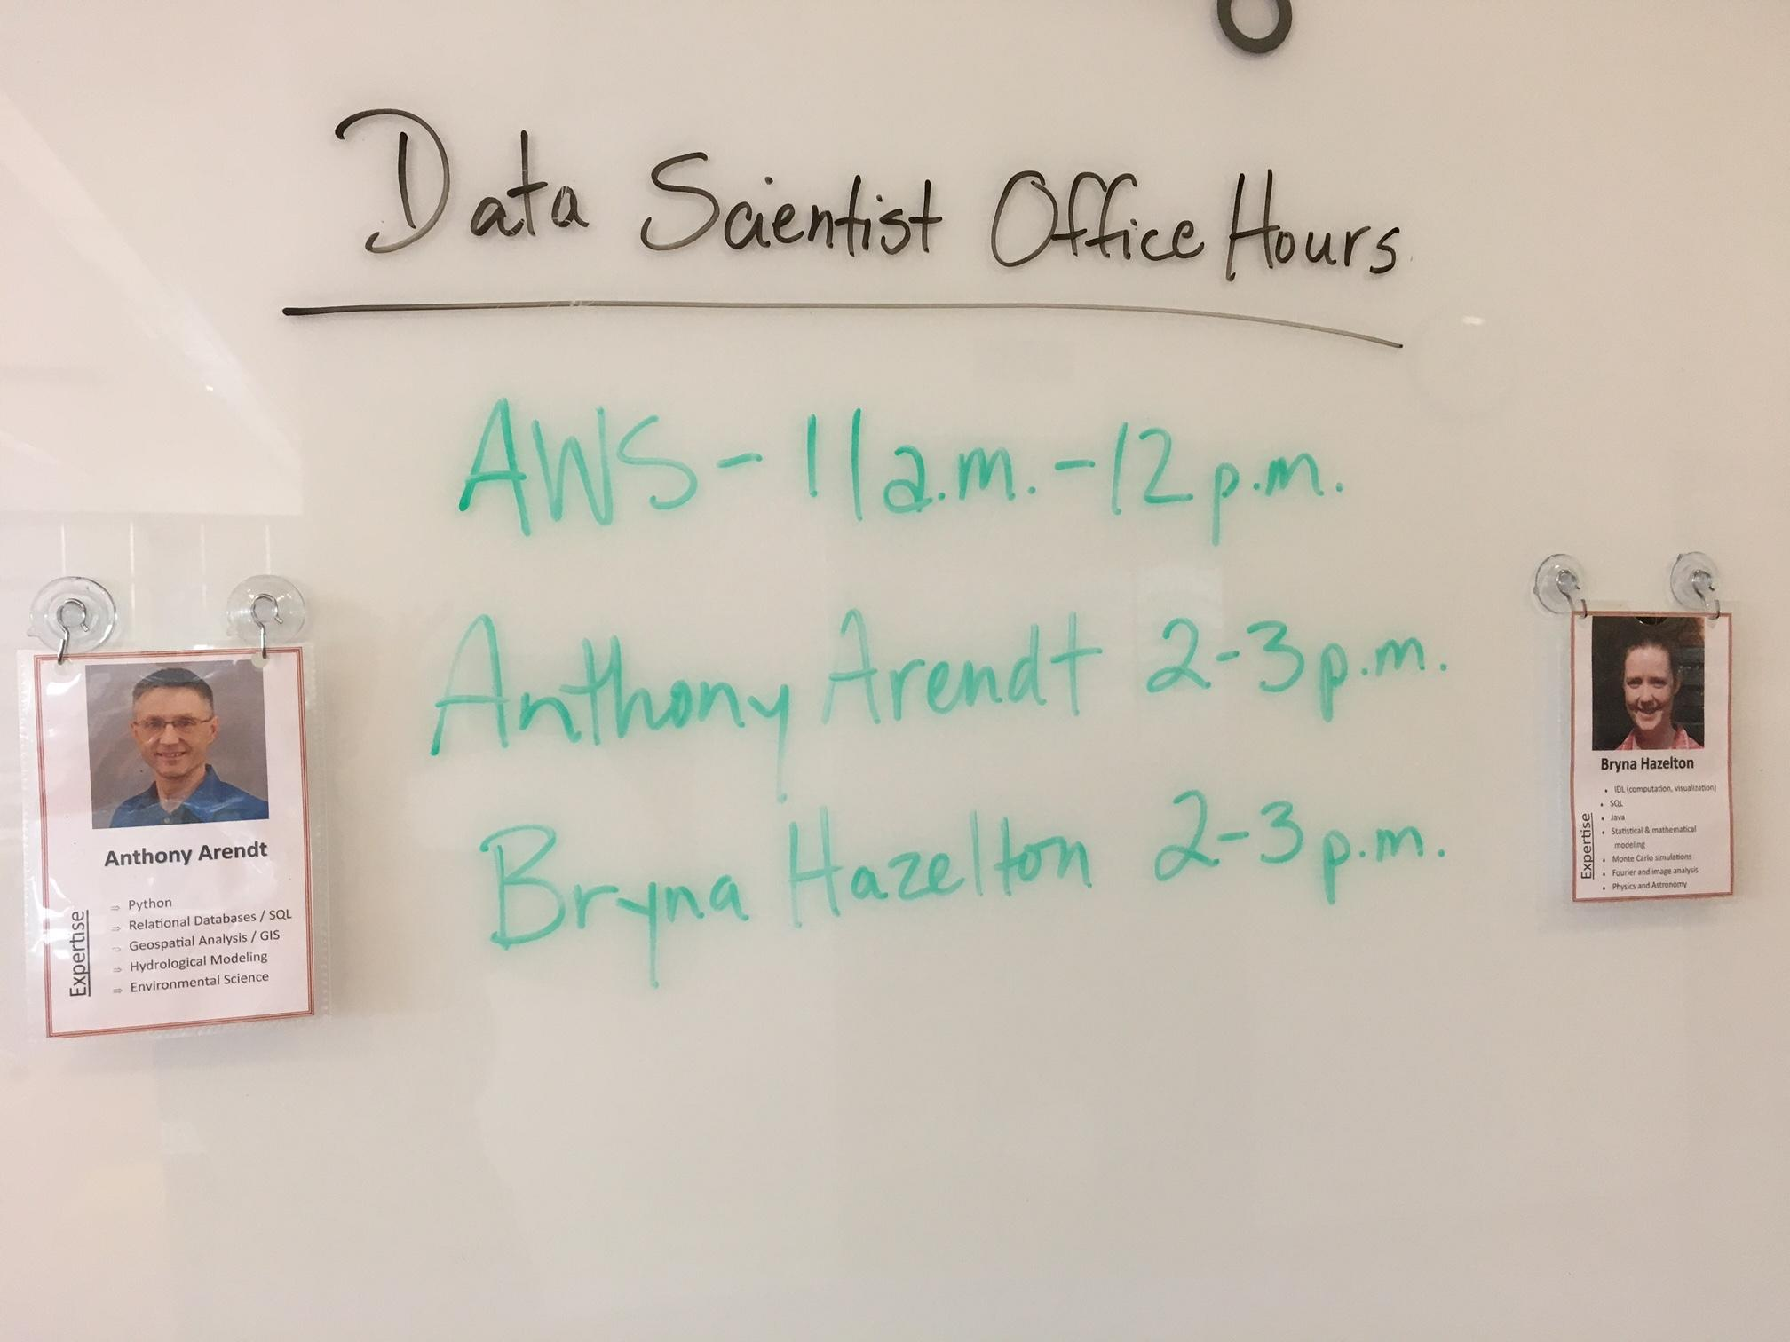

Office hours
(aka Drop-In Consulting)
In 2017-2018
~ 100 people helped from > 28 departments
Notes:
50 people helped by DS/RS
46 people helped by outside speakers

Slide 17
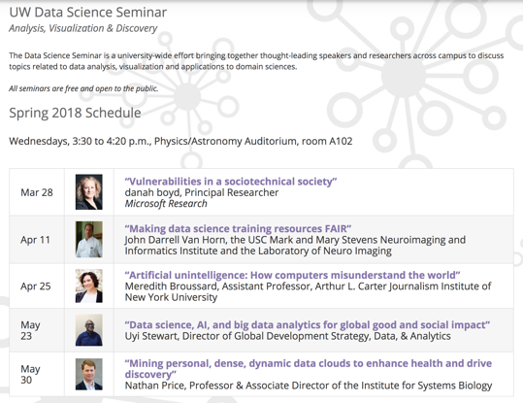
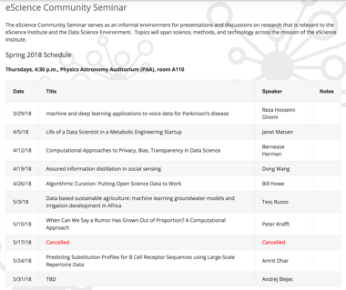
eScience Seminars
Weekly seminar * 3 quarters
9 distinguished speakers in 2017-18
Notes:
Rounded 486 to “nearly 500”. So average is 54 attendees / seminar

Slide 18
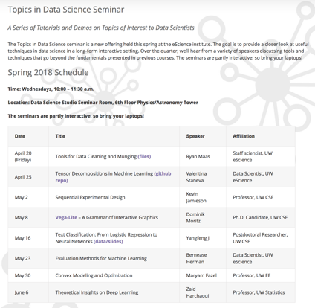
eScience Seminars
New This Year!

Slide 19
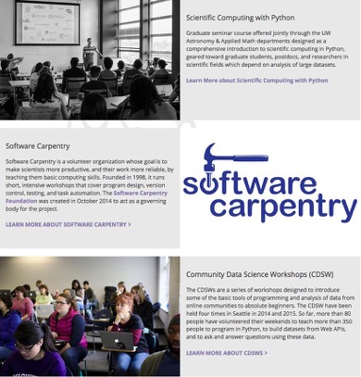
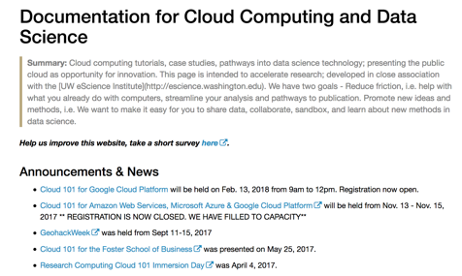
Various short courses and workshops
Total for the past academic year over 12 events and ~400 attendees
Notes:
1) Software Carpentry: 4*60 = 240
2) Software/Data Carpentry Instructor Training @ 40 people with 2 events
2.1) May 21st-22nd @ 17 participants
2.2) West Big Data Innovation Hub, Software/Data Carpentry Instructor Training (23 participants from six different areas around the Western USA) in March.
3) Data carpentry 1 event @ 25 people → Already counted in software carpentry
4) Cloud workshops: 4 events with > 50 people
Feb 13, 2018: Google Cloud Platform, Cloud 101 - approx. 20 people
Nov. 15, 2017: GCP Cloud 101 - 10 people
Nov. 14, 2017: Azure Cloud 101 - 6 people
Nov 13, 2017: AWS Cloud 101 - 15 people
5) Advanced Git workshop which had about 20 people
6) Intro to Git&Github (tutorial), Cabled Array Hackweek, Seattle, 2018 (~25)
7) Intermediate Git&Github (tutorial with Bernease), Winter, 2018 (~18)
Total:
13 workshops @ ~390 people.
tha

Slide 20


Hack weeks - Community-based learning
Tutorials
Project work
Peer-learning
Notes:
“Communal” hackathon model: placing a strong focus on cultivating data science literacy, building a culture of practice and developing resources within an existing domain-specific community.
By bringing together researchers from many different universities to address methods challenges within a research domain, Hackweeks take advantage of a shared language and scientific objectives
peer-teaching and -learning happens within the project work and is a major component of the hackweeks. Surveys indicate 70-80% of participants teach other participants during a hackweek.
Really powerful for fostering collaboration and learning among people from various stages of their career and technical abilities, and catalyzing a community through a shared interest in solving computational challenges within a field

Slide 21

eScience Institute Role at the U of Washington and Beyond
Education
Disseminate Data Science Expertise and Best Practices
Lead Data Science Education at UW
Research
Advance the State of the Art in Data Science
Make the World a Better Place
Community
Hub of data science community
Partnerships

Slide 22


We Lead Data Science Education at UW

Slide 23
Educational objectives
Goal 1: Educate ALL students in data science
Introductory courses with no pre-requisites
Tracks to advanced course work within departmental majors
Goal 2: Create interdisciplinary communities of data science practitioners
Goal 3: Provide both formal curricular training pathways as well as informal “ad hoc” training opportunities

Slide 24

Notes:
Master’s program:
This academic year, 22 students graduated from the program. This is approximately half of the first cohort of students, the others are enrolled part-time and most will graduate next year.
An additional 56 students will be continuing in the program next year.
In September, 44 new students will enroll in the program. There will be 110 students in the program during fall and winter quarters, many will graduate in March 2019.
This year we received 753 applications, up from 513 applications the previous year.
98 offers of admission were made, so the yield rate is about 44.9%
Is there any other information you would like?

Slide 25

Participating Departments and Schools
Paperwork submitted: Atmospheric sciences and bioengineering
Working on joining: All engineering departments, geography, anthropology, chemistry, linguistics, economics, classics, Evans school, SPH, AES
Notes:
Geography: Chair Lucy Jarosz (jarosz@uw.edu)
Anthropology: Prof. Ben Marwick.
Chemistry: David is working with them.
Classics: Catherine M. Connors (cconnors@u.washington.edu). Thinking
Linguistics: Richard Wright (rawright@uw.edu). They are interested.
Economics: Fahad Khalil (khalil@uw.edu). Michelle Turnovsky followed up with us.
AES: American Ethnic Studies

Slide 26
eScience Institute Role at the U of Washington and Beyond
Education
Disseminate Data Science Expertise and Best Practices
Lead Data Science Education at UW
Research
Advance the State of the Art in Data Science
Make the World a Better Place
Community
Hub of data science community
Partnerships

Slide 27

We Advance the State of the Art in Data Science

Slide 28

Scalable Research Impact Data Science Incubator Programs
(The space between Office Hours and Grant Proposals)
Move from “accidental” encounters to engineered partnerships
Identify emerging opportunities around campus
Provide a shared environment where researchers can learn from an in-house team, external mentors, and each other
Notes:
An incubation program to scale and concentrate our collaborations
We want to move from “accidental” encounters to engineered partnerships -- identify promising new opportunities and new partners around campus and invest our time with them.
We need a shared environment where researchers can learn not only from our team, but also external mentors and most importantly **each other** – we routinely find shared solutions across very different fields. John Wilkerson in political science is using sequence alignment algorithms from biology for text analytics to trace the flow of ideas through legislation. Image processing algorithms designed for galaxy detection in Astronomy are being used to analyze MRI data of the brain.

Slide 29

Winter Incubator Program
Quarter-long, in-Studio projects, engagement two days per week
Project Lead + Data Scientist
the “ah ha” moment!
4-6 concurrent projects: Network effects among cohort beyond 1:1 interactions
29 projects over the past 4 years, 21 departments represented
Participation from faculty, grad students, staff
What we're looking for: Projects where fruitful collaboration is possible, with potential for significant impact. “Do only what we can only do together”
Notes:
We find that short-term, intensive projects have high payoff but are difficult to support with external funding.
Participants sit with us and lead the project – the idea is to interact with each other as much as us
If we can identify collaborations that lead to new science and new methodologies, that’s even better.

Slide 30
Winter 2018 Incubator
Experimental diffusion analysis to extract tissue structure function in the diseased brain – Chemical Engineering
Deciphering climate clues via carbon flux simulation – Atmospheric Sciences
Incubating a DREAM – Civil and Environmental Engineering
Political Twitter images project summary and goals – Political Science
Hitting the mark: targeting strategy development for SDSS V with a robotic fiber positioning system – Physics & Astronomy

Slide 31


Slide 32


Slide 33
Summer 2018 DSSG, kicked off June 11th!
Access to Out-of-School Opportunities and Student Outcomes – Center on Reinventing Public Education, University of Washington, Bothell
Automatic damage annotation on post-hurricane satellite imagery – Industrial & Systems Engineering, University of Washington, Seattle
Seattle Mobility Index Project - Seattle Department of Transportation
Notes:
1) Jake Vanderplas. ORCA card. Dirty data
2) Vital Signs collects and integrates data on Agriculture, Ecosystems and Human Well-Being across several African nations
sustainable agricultural -- optimize agricultural development decisions
3) Understand downtown seattle traffic.
4) Gentrification, equity, understand the changes in Seattle.
In the past years, Seattle has seen unprecedented population growth, record construction activity, and an increase in housing cost, creating an affordability crisis for a large portion of the urban population. The “Equity Modeler” team is investigating the ongoing gentrification process and inequitable access to opportunities across many of Seattle’s neighborhoods.

Slide 34





Slide 35
eScience Institute Role at the U of Washington and Beyond
Education
Disseminate Data Science Expertise and Best Practices
Lead Data Science Education at UW
Research
Advance the State of the Art in Data Science
Make the World a Better Place
Community
Hub of data science community
Partnerships

Slide 36



Working Groups

Slide 37

New Research-Themed Working Groups
New This Year!
NSF Tripods

Slide 38




We Build a Community
255 attendees, although only 216 spots!
Nearly 900 students and 45 companies

Slide 39




Build multi-sector, multi-state partnerships to address societal challenges with Big Data innovation
Connect. Convene.
Curate. Communicate.
Notes:
building connective fabric through ACTION.
Creating a movement – data collborations to address scientific and societal challenges.

Slide 40


Four hubs, one mission.
WEST
MIDWEST
build and strengthen partnerships
across industry, academia, nonprofits, government
to address societal + scientific challenges,
spur economic development,
and accelerate innovation in the big data ecosystem
NORTHEAST
SOUTH
Hub PI institution

Slide 41




West Hub Priority Areas
Diagnostics, Treatment, Genomics, Environment/ Exposome
METRO DATA SCIENCE
Smart Cities + Communities, Transportation, Housing, Police Data, Economic Development
PRECISION MEDICINE
NATURAL RESOURCES
DATA-ENABLED SCIENTIFIC DISCOVERY + LEARNING
Water, energy, agriculture, disaster response + recovery, sustainability
+ HAZARDS
Open science, reproducibility, education, workforce development
CROSS-CUTTING EFFORTS:
Cloud Computing Task Force
Public Policy, Ethics, Privacy, Security
Data Sharing, Infrastructure
Data-Driven Storytelling / Data Literacy
Data Hackathons Community of Practice
+ more
Notes:
The good news: Text is basically everywhere and in everything
Meaningful research, connecting to broader social implications
No single university, sector, have all the answers or resources
Focus in on 3 examples showing how the Hubs can be a vehicle for connecting with collaborators

Slide 42

https://westbigdatahub.org/

Slide 43
Opportunities to engage with eScience…
Join our mailing list, “opt in” on the eScience homepage
Become an eScience Affiliate
NEW - Industry affiliate program
Hang out in the Data Science Studio, 6th floor Physics/Astronomy Tower
Drop in for data science consultation hours
Submit an Incubator or DSSG proposal
Join a working group, attend a seminar
Participate in Software Carpentry, hack week, etc.
Collaborate on a grant proposal
Share your ideas and pain points…lets work together!

Slide 44






Thank You!
exec-director@escience.washington.edu
Notes:
Lead the advancement in data science methodologies
Lead the utilization of these methodologies in discovery
Lead the creation of environments where data science can flourish

Slide 45
Links
“Creating Institutional Change in Data Science” Chronicles of Higher Ed, Mar 2018
(http://msdse.org/creating_institutional_change.html)
“Hack Weeks as a model for Data Science Education and Collaboration”
(arXiv:1711.00028)
eScience Winter Incubator:
http://escience.washington.edu/get-involved/incubator-programs/overview/
UW Data Science for Social Good:
http://escience.washington.edu/dssg/

